Slide 1
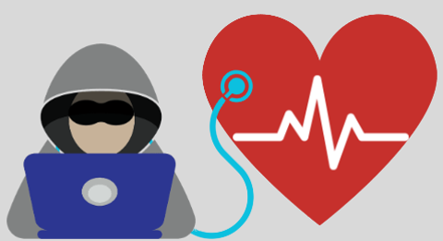
"Cybersecurity in Healthcare"

Slide 2
Content
Introduction
Healthcare Data Landscape.
Types of Security Breaches in Healthcare.
Importance of Cybersecurity in Healthcare.
Why we need modernization in healthcare.
Regulatory Compliance
Cybersecurity Measures and Best Practices in Healthcare
Impact of COVID-19 on Healthcare Cybersecurity
Case study
Conclusion

Slide 3
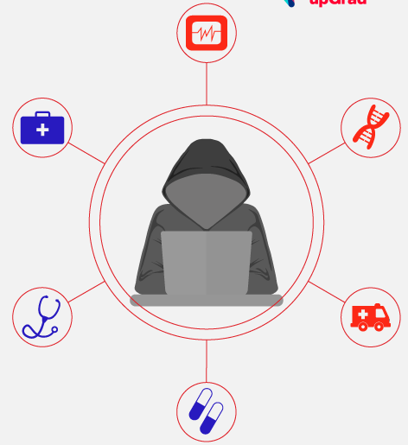
Introduction
Safeguarding healthcare data and systems involves ensuring the secrecy, accuracy, and accessibility of information, known as the CIA triad in cybersecurity.
It is a critical issue for healthcare organizations, as they collect and store a large amount of sensitive patient information, such as medical records, financial data, and insurance information.
This data is a valuable target for cybercriminals, who may use it to commit identity theft, fraud, or blackmail.

Slide 4
Healthcare Data Landscape
The healthcare data landscape includes the collection of data from various sources.
Electronic Health Records (EHRs)
Medical Imaging data
Administrative and Billing Data
Internet of Medical Things (IoMT)
Genomic and Research Data
Interoperability and Health Information Exchange (HIE)

Slide 5
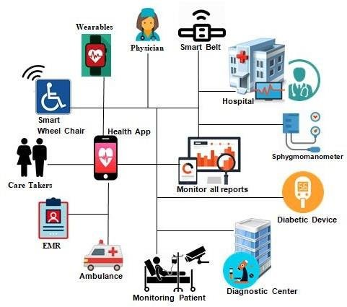
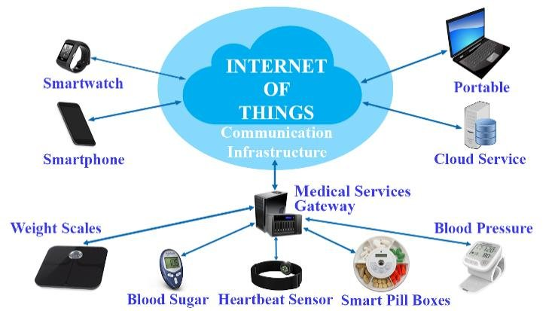
IOMT Devices

Slide 6
Where IOMT devices work
Real-Time Patient Monitoring
Patient-doctor communication
Medication usage
Remote Care and Telemedicine
Enhanced Workflow and Efficiency
Improved Diagnostics and Treatment

Slide 7
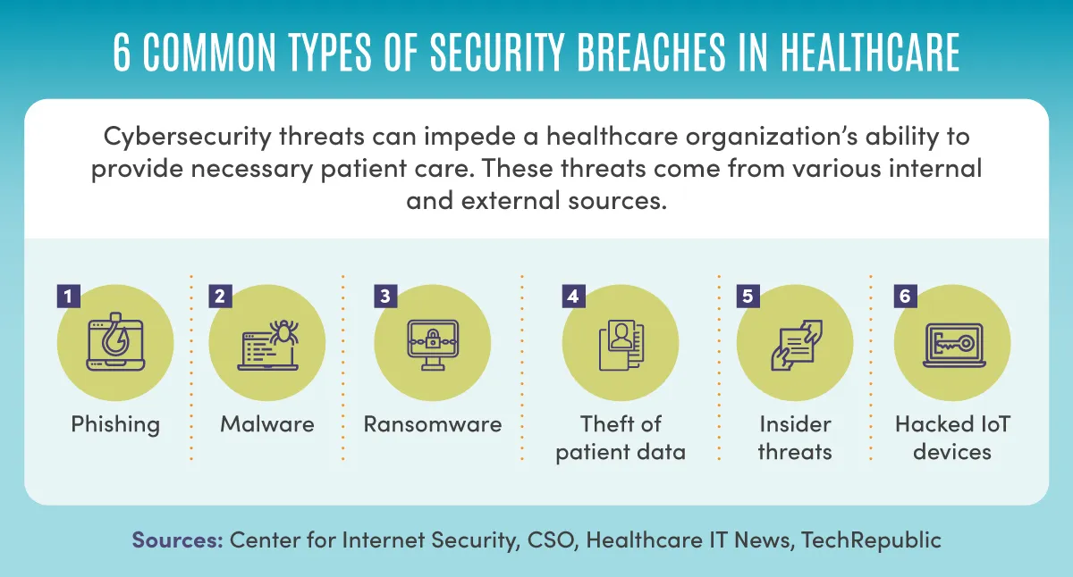

Slide 8
Importance of Cybersecurity in Healthcare
Protection of Sensitive Data
Patient Trust and Confidentiality
Preventing Disruption of Services
Compliance with Regulations
Medical Device Security
Data Integrity and Accuracy
Financial Impact
Research and Development Protection

Slide 9
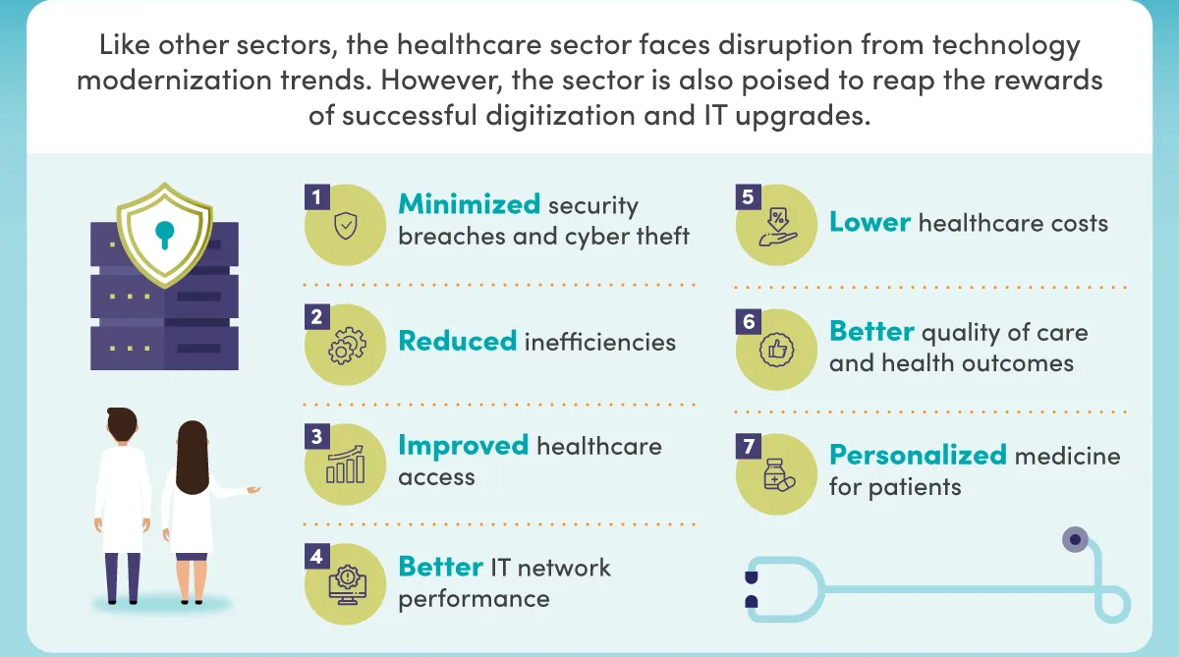
Why we need modernization in Healthcare

Slide 10
Regulatory Compliance
Regulatory compliance is the process of following laws, regulations, and other rules set by governments and regulatory bodies
Digital Personal Data Protection Bill, 2023 (DPDPB): That aims to regulate the collection, storage, and use of personal data by organizations. Right to be informed, Right of access, Right to erasure.
HIPAA (Health Insurance Portability and Accountability Act): Focuses on protecting the privacy and security of patient information (PHI) by setting standards for its safeguarding.
HITECH Act (Health Information Technology for Economic and Clinical Health Act): Works in conjunction with HIPAA, emphasizing the secure handling of electronic protected health information (ePHI) and promoting the adoption of health information technology.

Slide 11
Cybersecurity Measures and Best Practices in healthcare
Access Control and Authentication
Regular software updates and patches
Employee training on cybersecurity awareness
Incident response planning
Secure Network Infrastructure
Secure Telehealth
Data Backups and Recovery

Slide 12
Impact of COVID-19 on Healthcare Cybersecurity
Increased cyber threat attacks
Resource strain
Exploitation of vulnerabilities in telemedicine
Increased insider threats

Slide 13
Case study: RANSOMWARE ATTACK ON AIIMS
November 23, 2022: AIIMS New Delhi faced a major cyberattack, its servers and eHospital network stopped working forcing AIIMS to adopt all functions to manually operate.
The attackers compromised the personal identifiable information (PII) of patients and healthcare workers.
CERT-In discovered two Proton mail associated with the hackers: "dog2398" and "mouse63209.“
The targeted servers were infected with three ransomware : Wammacry, Mimikatz, and Trojan.
Cyberattack was the result of an "unorganized ICT (information and communications technology) network without centralized monitoring or system administration.”

Slide 14
Conclusion
Healthcare organizations are prime targets for cyberattacks due to the valuable data they hold, such as patient medical records and financial information.
Cyberattacks on healthcare organizations can have severe consequences, including data breaches, disruptions to patient care, and reputational damage.
By prioritizing cybersecurity, healthcare organizations can safeguard patient privacy, ensure the delivery of high-quality care, and maintain public trust

Slide 15
Reference
The Effects of Cyber-Security on Healthcare Industry, 2017 https://www.researchgate.net//
Cybersecurity in healthcare: a narrative review of trends, threats and ways forward, 2018 https://nrl.northumbria.ac.uk/
Cybersecurity in the healthcare security, 2021 https://podiatrym.com/pdf/2021/7/Chua821web.pdf
https:// 2023/03/22/topic-cyberattack-on-critical-information-ci-infrastructure-a-case-study-of-ransomware-on-aiims/
https://thewire.in/government/aiims-servers-cyberattack-ransomware-rajya-sabha

Slide 16

Thank you

